Slide 1
Logic Synthesis:
From Boolean Algebra to SAT

Slide 2
Table of Contents
Bool tree
Binary Decision Diagram
Circuit equivalent check (CEC)
8-queens
SAT
8-queens
Sudoku

Slide 3
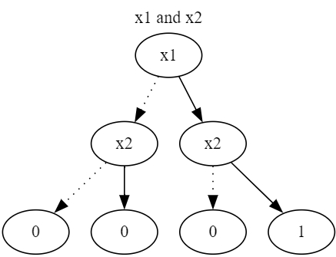
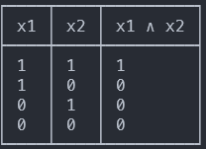
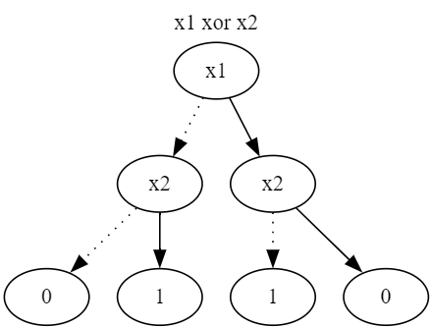
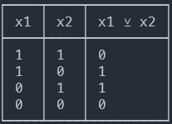
Truth Table and Bool Tree

Slide 4
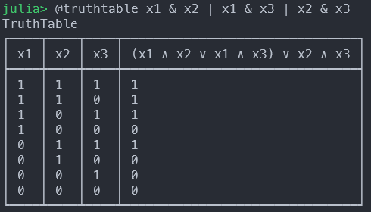
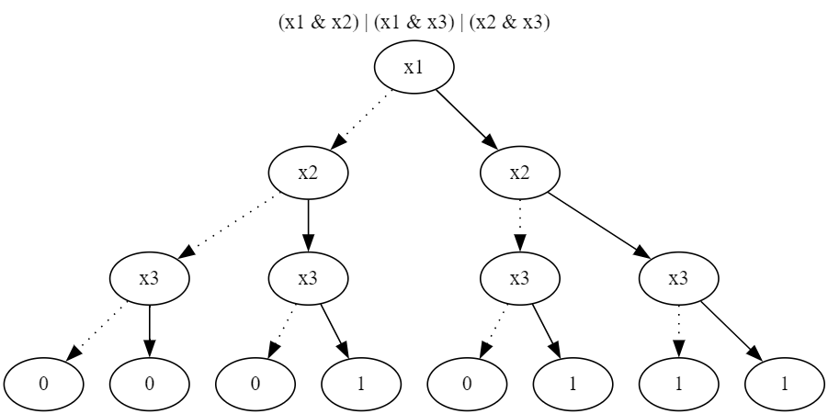
Majority gate (MAJ3)

Slide 5
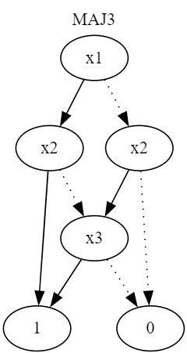
Reduced Ordered Binary Decision diagram

Slide 6
Shannon’s decomposition
$F=xF_{x}+\overline{x}F_{\overline{x}}$
If-Then-Else operator (MUX)
$ite\left(F,G,H\right)=F∙G+\overline{F}∙H$
*ROBDD is a canonical representation

Slide 7

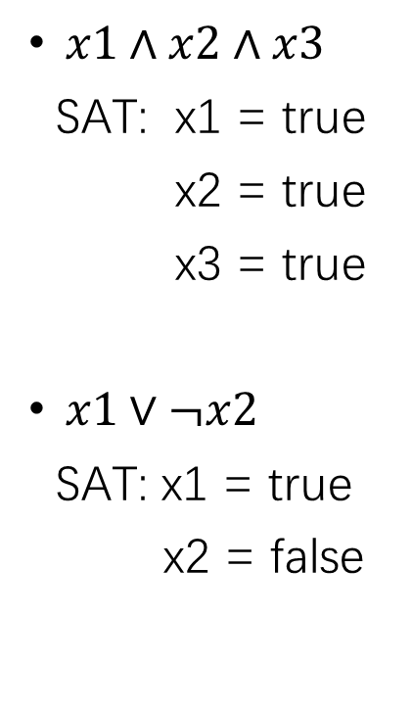
Boolean satisfiability problem (SAT)
$x1∧x2∧x3$
SAT: x1 = true
x2 = true
x3 = true
$x1∨¬x2$
SAT: x1 = true
x2 = false
$x1∧¬x1$
UNSAT
($x1⊕x2)∧x1∧x2$
UNSAT

Slide 8
Reference
BDD:
Andersen, Henrik Reif. "An introduction to binary decision diagrams." Internet, September (1996).
Brace, Karl S., Richard L. Rudell, and Randal E. Bryant. "Efficient implementation of a BDD package." Proceedings of the 27th ACM/IEEE design automation conference. 1991.
Cudd manual
SAT:
如何用一行代码打败修炼三十年的高数老师 – 蒋炎岩 NJU
Z3 Python API
Programming Z3 manual

